Slide 1
Interactive “Demo”
take a card
write your name on the first line
on the next line, write down whether you are a student (yes / no)
on the next line, write down your favorite color
on the next line, assuming money is not an issue, write down whether you would upgrade your computer equipment (yes / no)
on the last time, write down whether you’ve ever bought food on or near campus (yes / no)
hold on to your cards

Slide 2
Examining Different Forms of Bias in Algorithms
“Garbage in, garbage out”

Slide 3
When we talk about Bias, what do we really mean?
Data Collection Bias - Is our methodology truly getting a representative sampling of data?
Algorithmic Bias - Big data is becoming ever more inexorably linked with machine learning, but there are a number of questions that must be asked of machine learning algorithms when applied to data science:
Are the machine learning algorithms we’re using being fed a representative sampling of data?
Are the algorithms we’re using being used for a purpose which is supported by the data?
The Intersection of Algorithmic and Data Collection Bias - Broadly defined, does the data we’re collecting and on which we’re training our algorithms support the purpose for which we’re using this data? Are we marginalizing groups or individuals based on the results of the data collection and the algorithms we’re using to interpret this data?

Slide 4
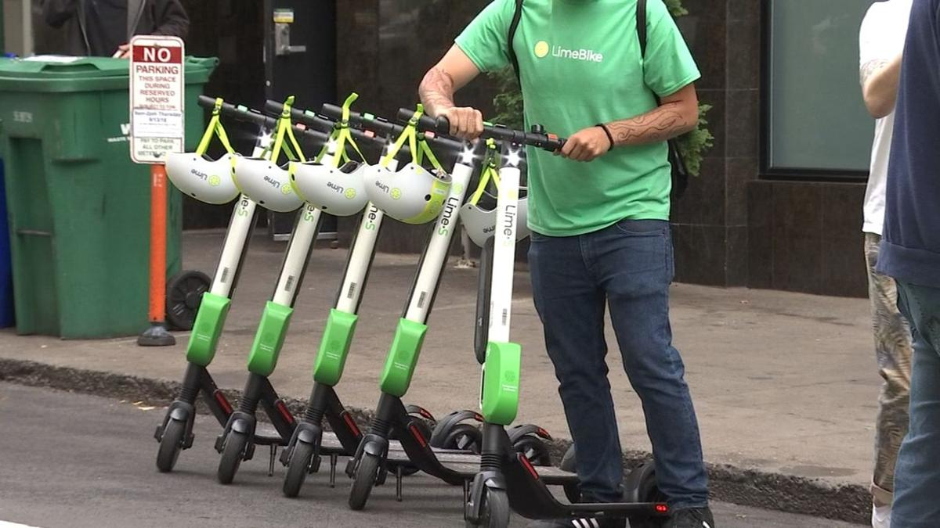
A prominent example of Data Collection Bias in Portland:

Slide 5
Amazon’s Rekognition Software
One of the forerunners on the plug and play machine learning data analysis software market, Amazon’s Rekognition software is a collection of machine learning algorithms tied together and accessible through a single API.
It’s in the news most frequently as a piece of facial recognition software…
However it also includes algorithms for natural language processing, pattern recognition in data, and other (non-facial recognition) image processing.
It’s currently used by the FBI and many regional and municipal law enforcement bureaus, including the Washington County Sheriff and Portland Police Bureau.
Amazon’s Rekognition website (https://aws.amazon.com/rekognition/) has some particularly interesting bullet points:
Simple integration and Low Cost
Batch and Real-Time Analysis
Fully Managed - providing consistent latency regardless of the size of your application’s requests
Security and Identity - “easily integrate face-based verification into new or existing applications with a single API”

Slide 6
But to what ends?
“There’s no silver bullet” - Fred Brooks

Slide 7
Gender Bias in Natural Language Processing

Slide 8
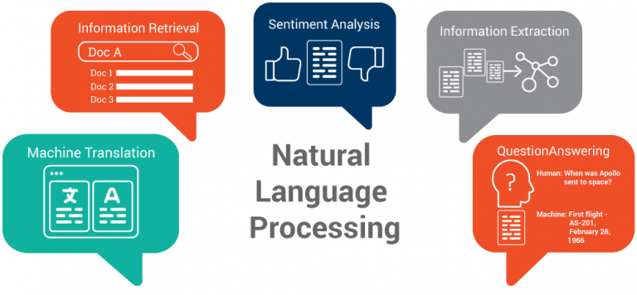
We’re Becoming Increasingly Dependent on NLP

Slide 9
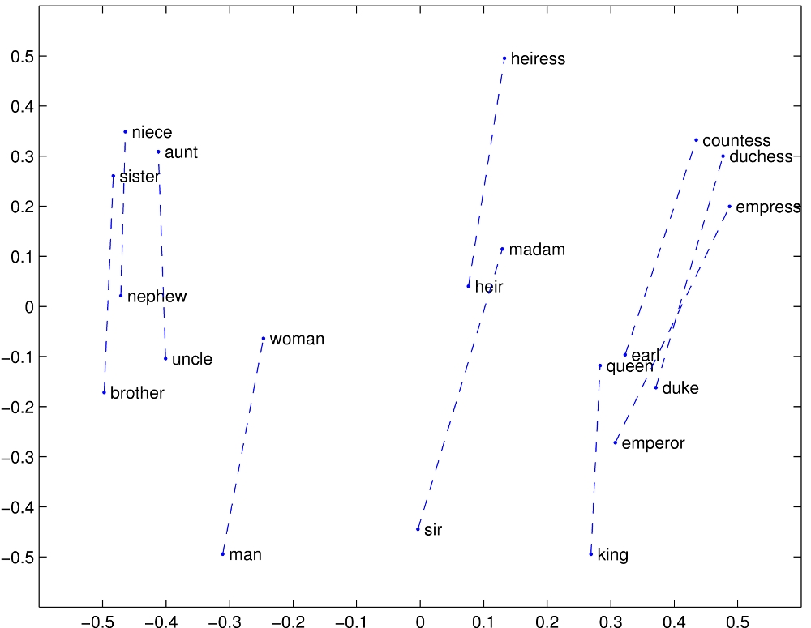
What are word embeddings?
Embeddings map semantic meaning to geometric space
Words that are semantically related should be closer together
The study used w2vNEWS, which is a popular, publicly-available embedding that was trained on a corpus of Google News texts consisting of 3 million English words.

Slide 10
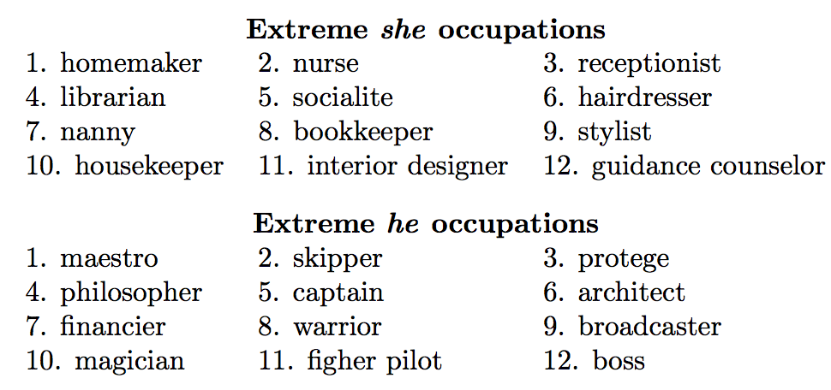
“Man is to Computer Programmer as Woman is to Homemaker? Debiasing Word Embeddings”
Direct bias. Compare the distance between a gender-neutral word embedding and a pair of gender-specific word embeddings.
nurse falls closer to woman than man
Indirect bias. Associations between gender-neutral words that are clearly arising from gender.
receptionist falls closer to softball than football

Slide 11
How did they reduce bias?
Identify bias direction
Then either:
Neutralize and Equalize (hard-debiasing): For every word that is not definitional, remove bias and equalize pairs
Soften (soft-debiasing): Reduce differences between sets while maintaining as much similarity to the original embedding as possible

Slide 12
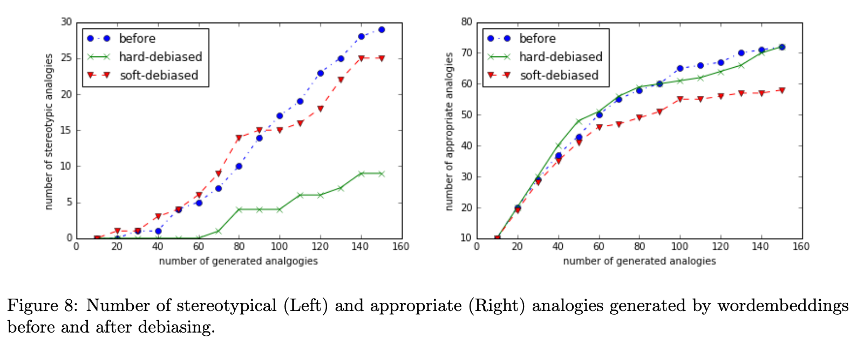
Results of Soft- and Hard-Debiasing of w2vNEWS

Slide 13
Discussion Questions

Slide 14
Who determines what’s biased?
To evaluate analogies, the researchers recruited 10 US-based Amazon Mechanical Turk workers and had them vote on whether or not they perceived the analogy as reinforcing a gender stereotype. If 5 or more workers said it was a gender stereotype, the analogy was labeled as biased.
Do you think 10 workers is a large enough population size to fairly and accurately classify the analogies? (Bear in mind that no details about the workers’ demographics were given beyond saying they were US-based.)
Do you think the results would have been different if they had included Mechanical Turk workers from other parts of the world?

Slide 15
Facial Recognition Software
& Automatic Gender Recognition

Slide 16
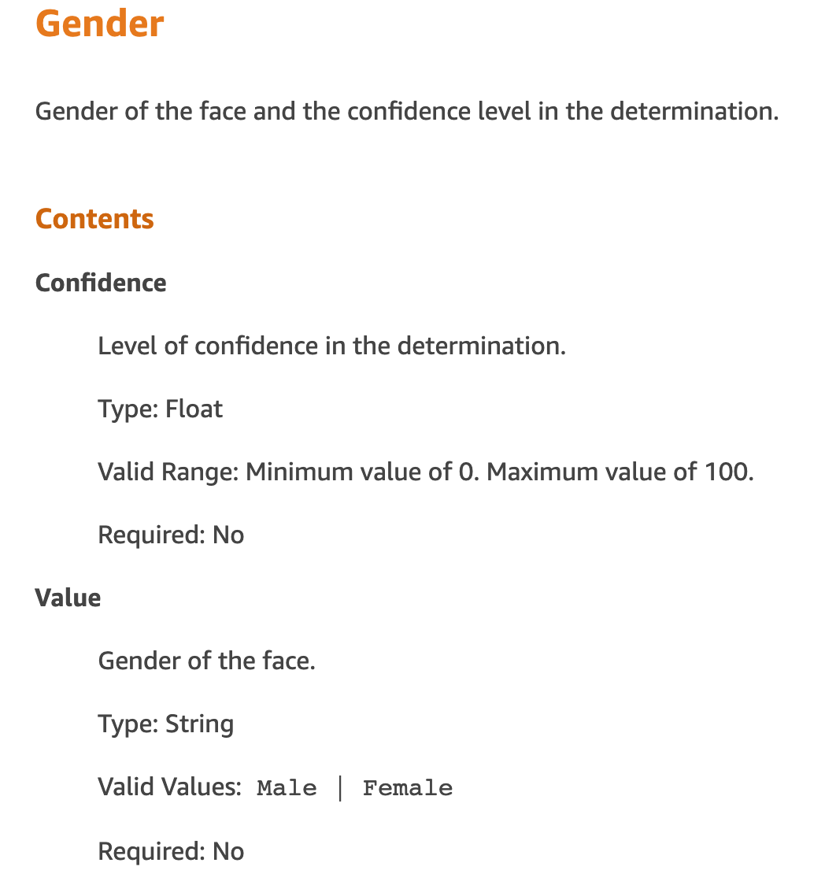
Amazon's Rekognition:
more stuff
A facial recognition software (FRS) that is particularly terrible at automatic gender recognition (AGR)

Slide 17


How accurate is Rekognition's AGR on Trans people?
10% more confident while rating transgender people...
...but highly inaccurate and very inconsistent
The Gender Spectrum Collection
Shutterstock
Female!
Male!
Male!
Female!
Female!
Male!
Male?
Male?
Male!
Female!
Misgendered: 31%
Misgendered: 4%
*Jezebel, June 2019

Slide 18



How accurate is Rekognition's AGR on a more typical data set?
~100%
29%
31%
*University of Toronto undergraduate Deb Raji, Feb 2019

Slide 19

Well that's terrible, but who even uses facial recognition software, anyhow?
Advertisements and user analytics:
Large advertising firms
Small businesses
A pizza shop in Oslo showed pizza ads to men, and salads to women
Mobile Phones:
Unlocking
Kid's games and apps

Slide 20
But that's all pretty harmless, right?
Rekognition's biggest customers are government agencies and police stations.
US Customs and Border Protection, at the Mexico border and in domestic airports
Police stations all around the US use it for identification
The NYPD combines forensic sketches, photoshop, and celebrity look-alikes to identify suspects using FRS
China uses FRS to track and racially profile Uighurs, a minority Muslim population

Slide 21
Wow. So how does bias creep in?
Design flaws: specifically designing software around the "easiest" data set and purposefully excluding edge cases
...Like Amazon making a facial recognition software that ignores:
trans and gender non-conforming people
intersex people
people with certain medical conditions, like hirsutism
racial minorities
women
In contrast, Microsoft isn't selling its FRS specifically because it was trained primarily on white men
Microsoft concluded its use would lead to innocent women and minorities being held for questioning

Slide 22


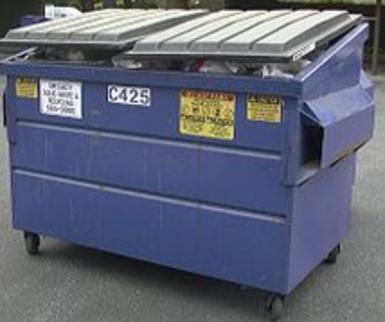
Biased data sets
Algorithms are magnifiers of bias.
A biased society...
...creates a biased data set...
...that results in a biased algorithm

Slide 23
Preventing bias
Make sure women and minorities are represented and listened to on your development team
People are more likely to point out bias if it affects them
Treat minorities with respect--gather data with their input and permission
Plan for edge cases and abnormalities
This is real life, not class!
Carefully select an unbiased data set
That's not going to be Shutterstock or Google Images
And don't release a product if you know it's biased!

Slide 24
...Biases should be called out, just as one would hold a person accountable. There’s this increased danger when you embed that bias into an algorithm versus when a human makes a prejudiced decision. Someone will tell you it’s wrong, whether it’s the public or your boss.
With AI, we tend to absolve this responsibility. No one is going to put an algorithm in jail.
- Deb Raji, engineering student at the University of Toronto

Slide 25
Racial Bias
in
Criminal Justice

Slide 26
How does the criminal justice system use algorithms?
Among other uses, I’ll focus on the following applications:
Allocation of Law Enforcement Resources
Assisting Law Enforcement in the Field
Providing Sentencing Guidelines in Court

Slide 27
So What's the Problem?
The training data does not reflect the general population and therefore produce inconsistent results for different demographics.
The training data reflects the biases already occurring in the criminal justice system.

Slide 28
Allocation of Law Enforcement Resources
Police Departments are using algorithms to determine how to allocate resources, i.e. determining patrol routes and frequency.
Problem: there is already a high correlation between some groups and poverty levels, and a high correlation between poverty and conviction rates.
So the algorithms are working off already biased data when determining patrol routes / frequency.
This, in turn, further increases the likelihood of people in the overrepresented populations to again be overrepresented in the new arrest and conviction rates because they have higher rates of police contact.

Slide 29
Assist Law Enforcement in the Field
Algorithms like Rekognition are used by law enforcement to assist in identifying individual people. (Washington County 1st in nation to use it)
The higher rate of false positives for people with darker complexions, more feminine features, and in non-binary groups means these groups are more likely to be falsely identified as criminals by law enforcement in the field.
Just imagine being mis-identified as a violent criminal with an outstanding warrant when you're standing in line for a burrito at Tito’s... this would make for a bad day. 🌯 ➡👮!➡🙁

Slide 30
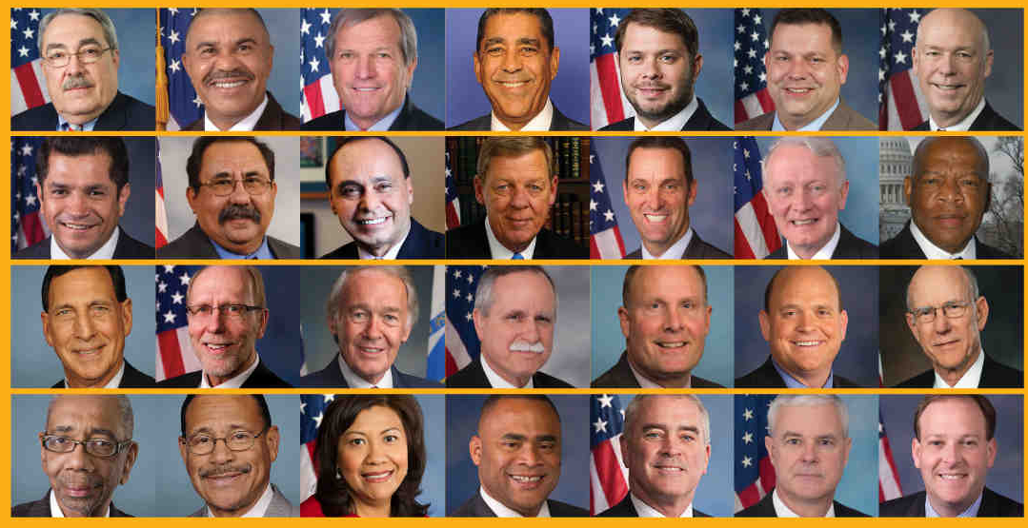
Rekognition is really bad at this…

Slide 31
Rekognition is really bad at this…
Rekognition is so bad at this, it erroneously paired 28 members of congress to mugshots.
Several different Amazon stakeholder groups are taking this issue seriously and demanded that Amazon stop selling the software to police departments until more rigorous controls are defined and implemented.

Slide 32
Sentencing Guidelines
Problem: There are recorded cases of the algorithms recommending disproportionate sentencing where race is the most notable differentiator.
A black woman and white man were arrested for theft of approximately the same amount . The black woman given tougher sentence than white man, even though the white man had an extensive criminal history (including armed robbery) and the woman had no criminal history.
The recommended sentences are based on the algorithms predicted rate of recidivism, but they are notoriously unreliable, and the companies providing this service offer no insight as to how the algorithms make their decision.

Slide 33
It's Not All Bad!
Some jurisdictions use the algorithms to:
determine which defendants are good candidates for alternative rehabilitation programs (shown to reduce growth rate of prison populations in Virginia)
or to determine which defendants are better suited for being released on bail vs. jail time (working well in Broward County, Florida... home to the famous "Florida Man" 🐊)
While there are known, observable flaws in the algorithms, they are still likely better than the old method of relying on judges' snap decisions which are subject to other outside influences.
Now that the algorithms are being used and observed, we have the ability to fix them as flaws are found.

Slide 34
Room for Improvement
Make the algorithms better: Some researchers have found ways to reduce the bias in algorithm results.
Decouple the task of identifying certain facial aspects such that they are identified independently from one another. Then recombine those attributes into composites of values downstream.
Training the algorithms to know the difference between race and gender characteristics would improve their performance.

Slide 35
Room for Improvement
Increased Visibility, Oversight, and Regulation
Allow reviews of algorithms innerworkings and actively seek disparity in treatment across sub-populations.
Create a certification process by independent 3rd parties - similar to above
Enlist the users themselves to monitor for undesirable algorithm behaviour, thus further training the algorithms after implementation.
Increased government regulation, like GDPR in Europe. People have the right to know how and why algorithms classify and treat them.
Fairness, Accountability, and Transparency in Machine Learning is a non-profit organization that hosts an annual conference to discuss these challenges and possible solutions. https://www.fatml.org/

Slide 36
Discussion Questions

Slide 37
Interactive “Demo”
take a card
write your name on the first line
on the next line, write down whether you are a student (yes / no)
on the next line, write down your favorite color
on the next line, assuming money is not an issue, write down whether you would upgrade your computer equipment (yes / no)
on the last time, write down whether you’ve ever bought food on or near campus (yes / no)
hold on to your cards

Slide 38

Here we go!
Thanks to pdxmugshots.com for this mugshot of a person arrested in Multnomah County on 07/08/2019.
https://mugshots.com/US-Counties/Oregon/Multnomah-County-OR/Conner-Skiles.178651739.html

Slide 39
Algorithm Bias in Medical Field

Slide 40
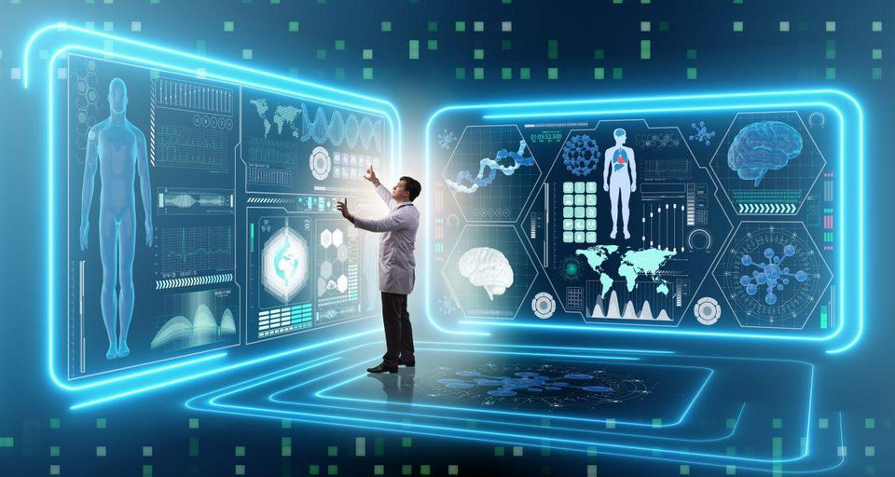
AI IN HEALTHCARE
AI assisted robotic surgery
Virtual nursing assistants
Aid Clinical judgement or diagnosis
Workflow and administrative tasks
Image Analysis

Slide 41
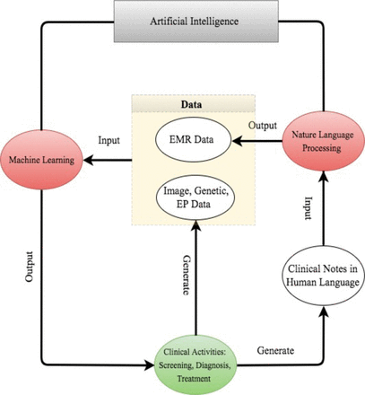
ROAD MAP OF AI IN HEALTHCARE
Machine Learning ( Structured Data)
Genetic, Imaging and Electrophysiological data
Natural Language Processing (Unstructured Data)
Clinical notes / Medical Journals

Slide 42
Racial Bias In An Algorithm that Guides Health Decisions in Millions
Already deployed in health care system
Decision for tens of millions affected every year.
Response to major policy changes
Incentives to manage population of patients
Major problem in Healthcare
Poor Management of Complex patients ( Multiple chronic conditions , Multiple Doctor visits)

Slide 43

Care coordination programs
When you have a problem - just call
Dedicated phone number
Low threshold to raising and solving issues
When you need it - Extra help
Dedicated staff of trained nurses
Help with medications
Extra slots for appointments

Slide 44
Algorithms come into effect
Programs are expensive - it targets the critical
Industry estimates - 150 million lives affected every year
Flag patients with complex health needs for Intervention before their health becomes catastrophic
Predict next year health care costs
Use claims data ( lesser degree of EHR Data)

Slide 45
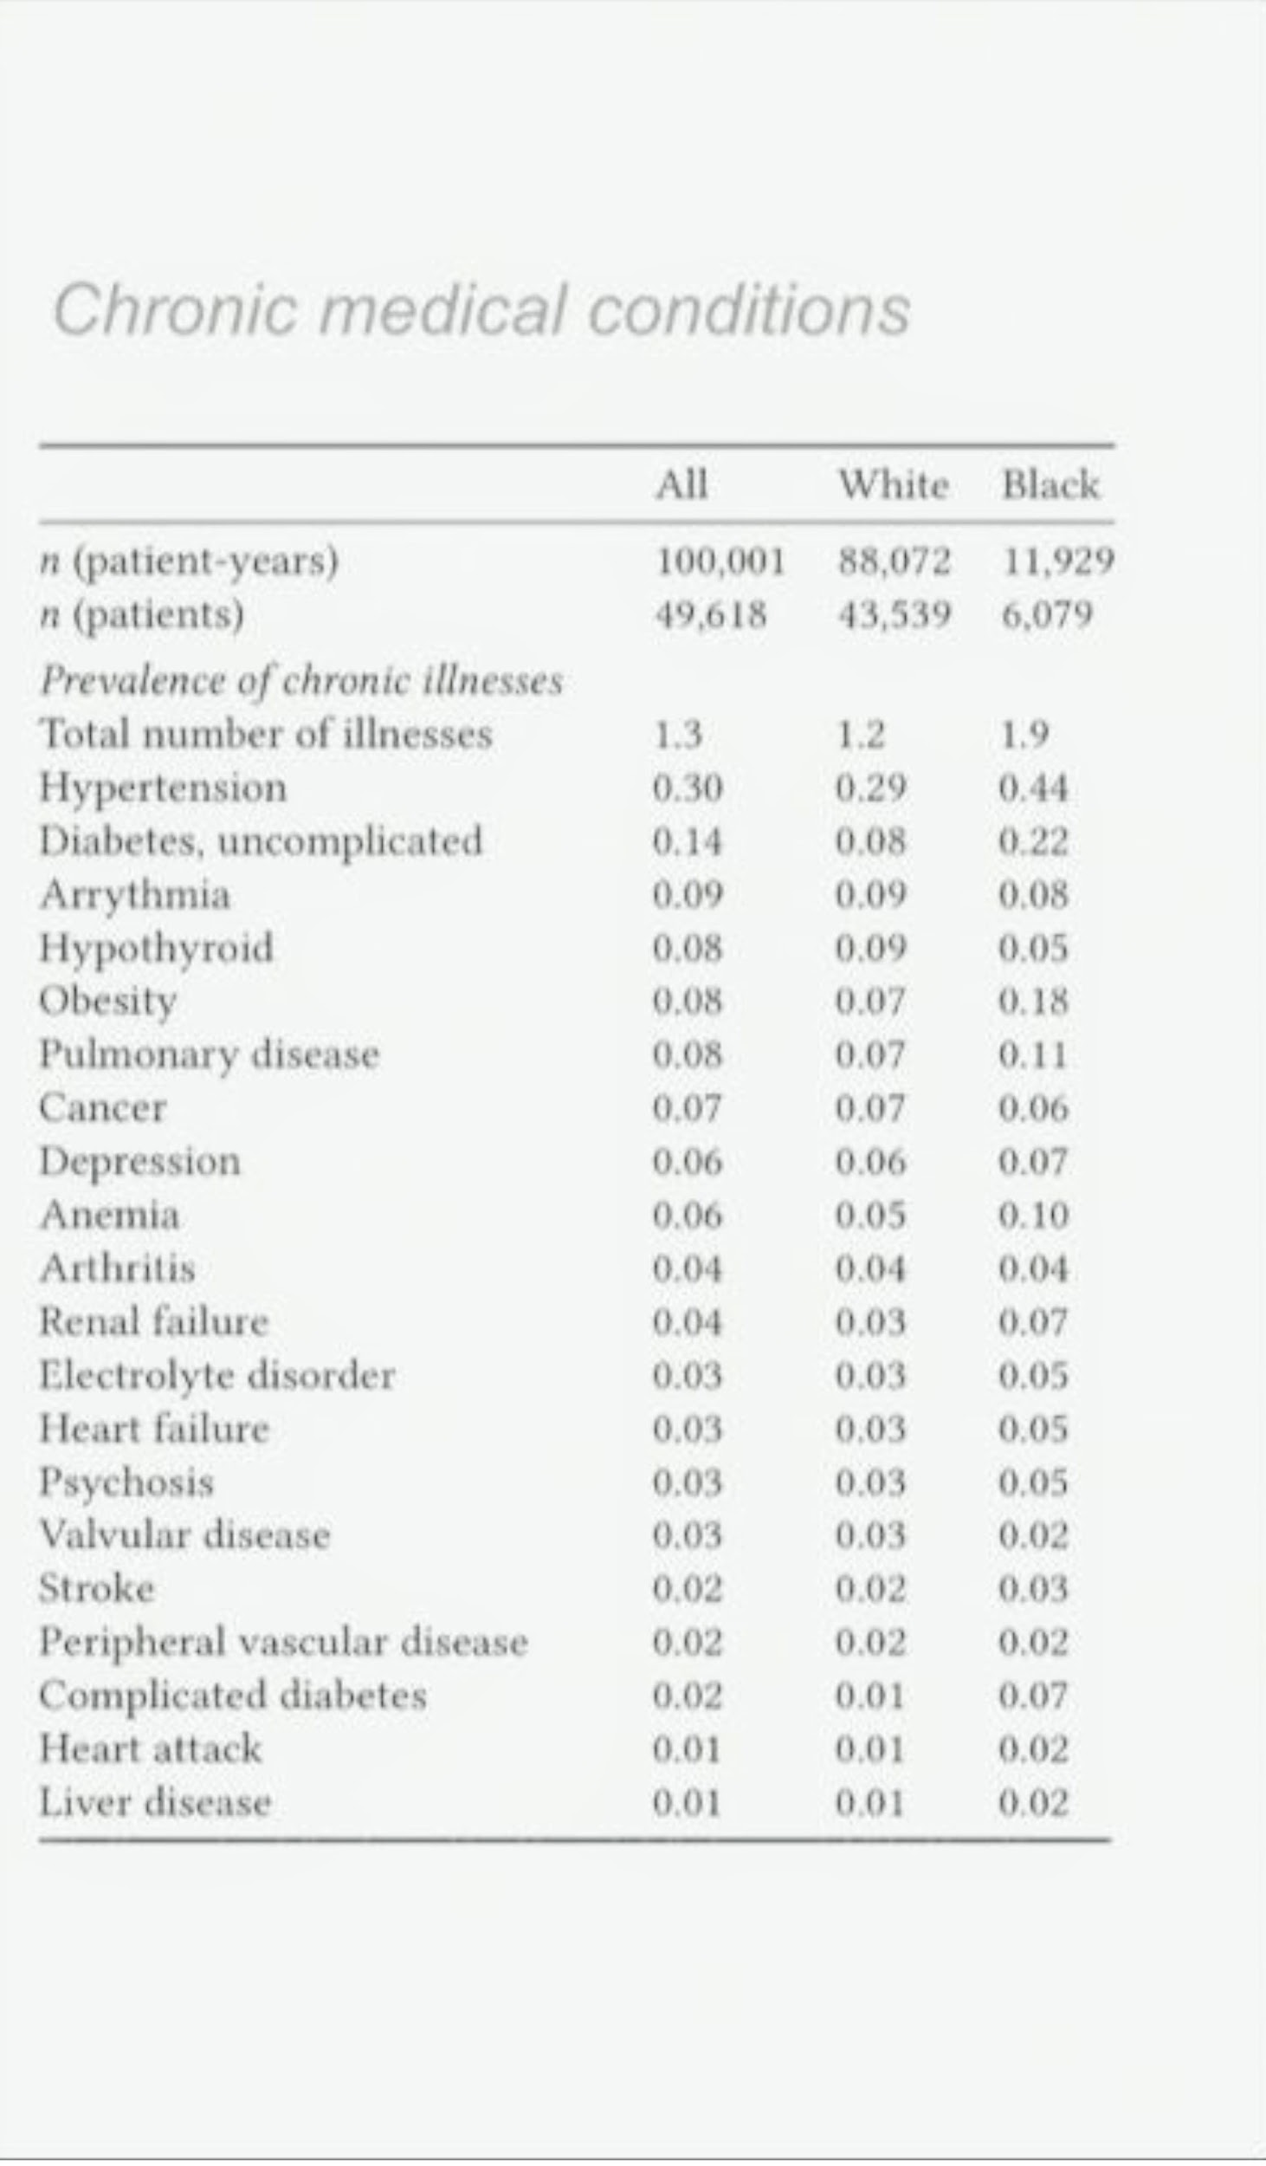
Analyzing the algorithm for racial bias
Algorithm trained on national claims dataset
Large primary care practice N = 43539 12% black
Algorithm score S used to screen the program
97 percentile auto identified for enrollment
55 percentile present the case to doctors for screening

Slide 46
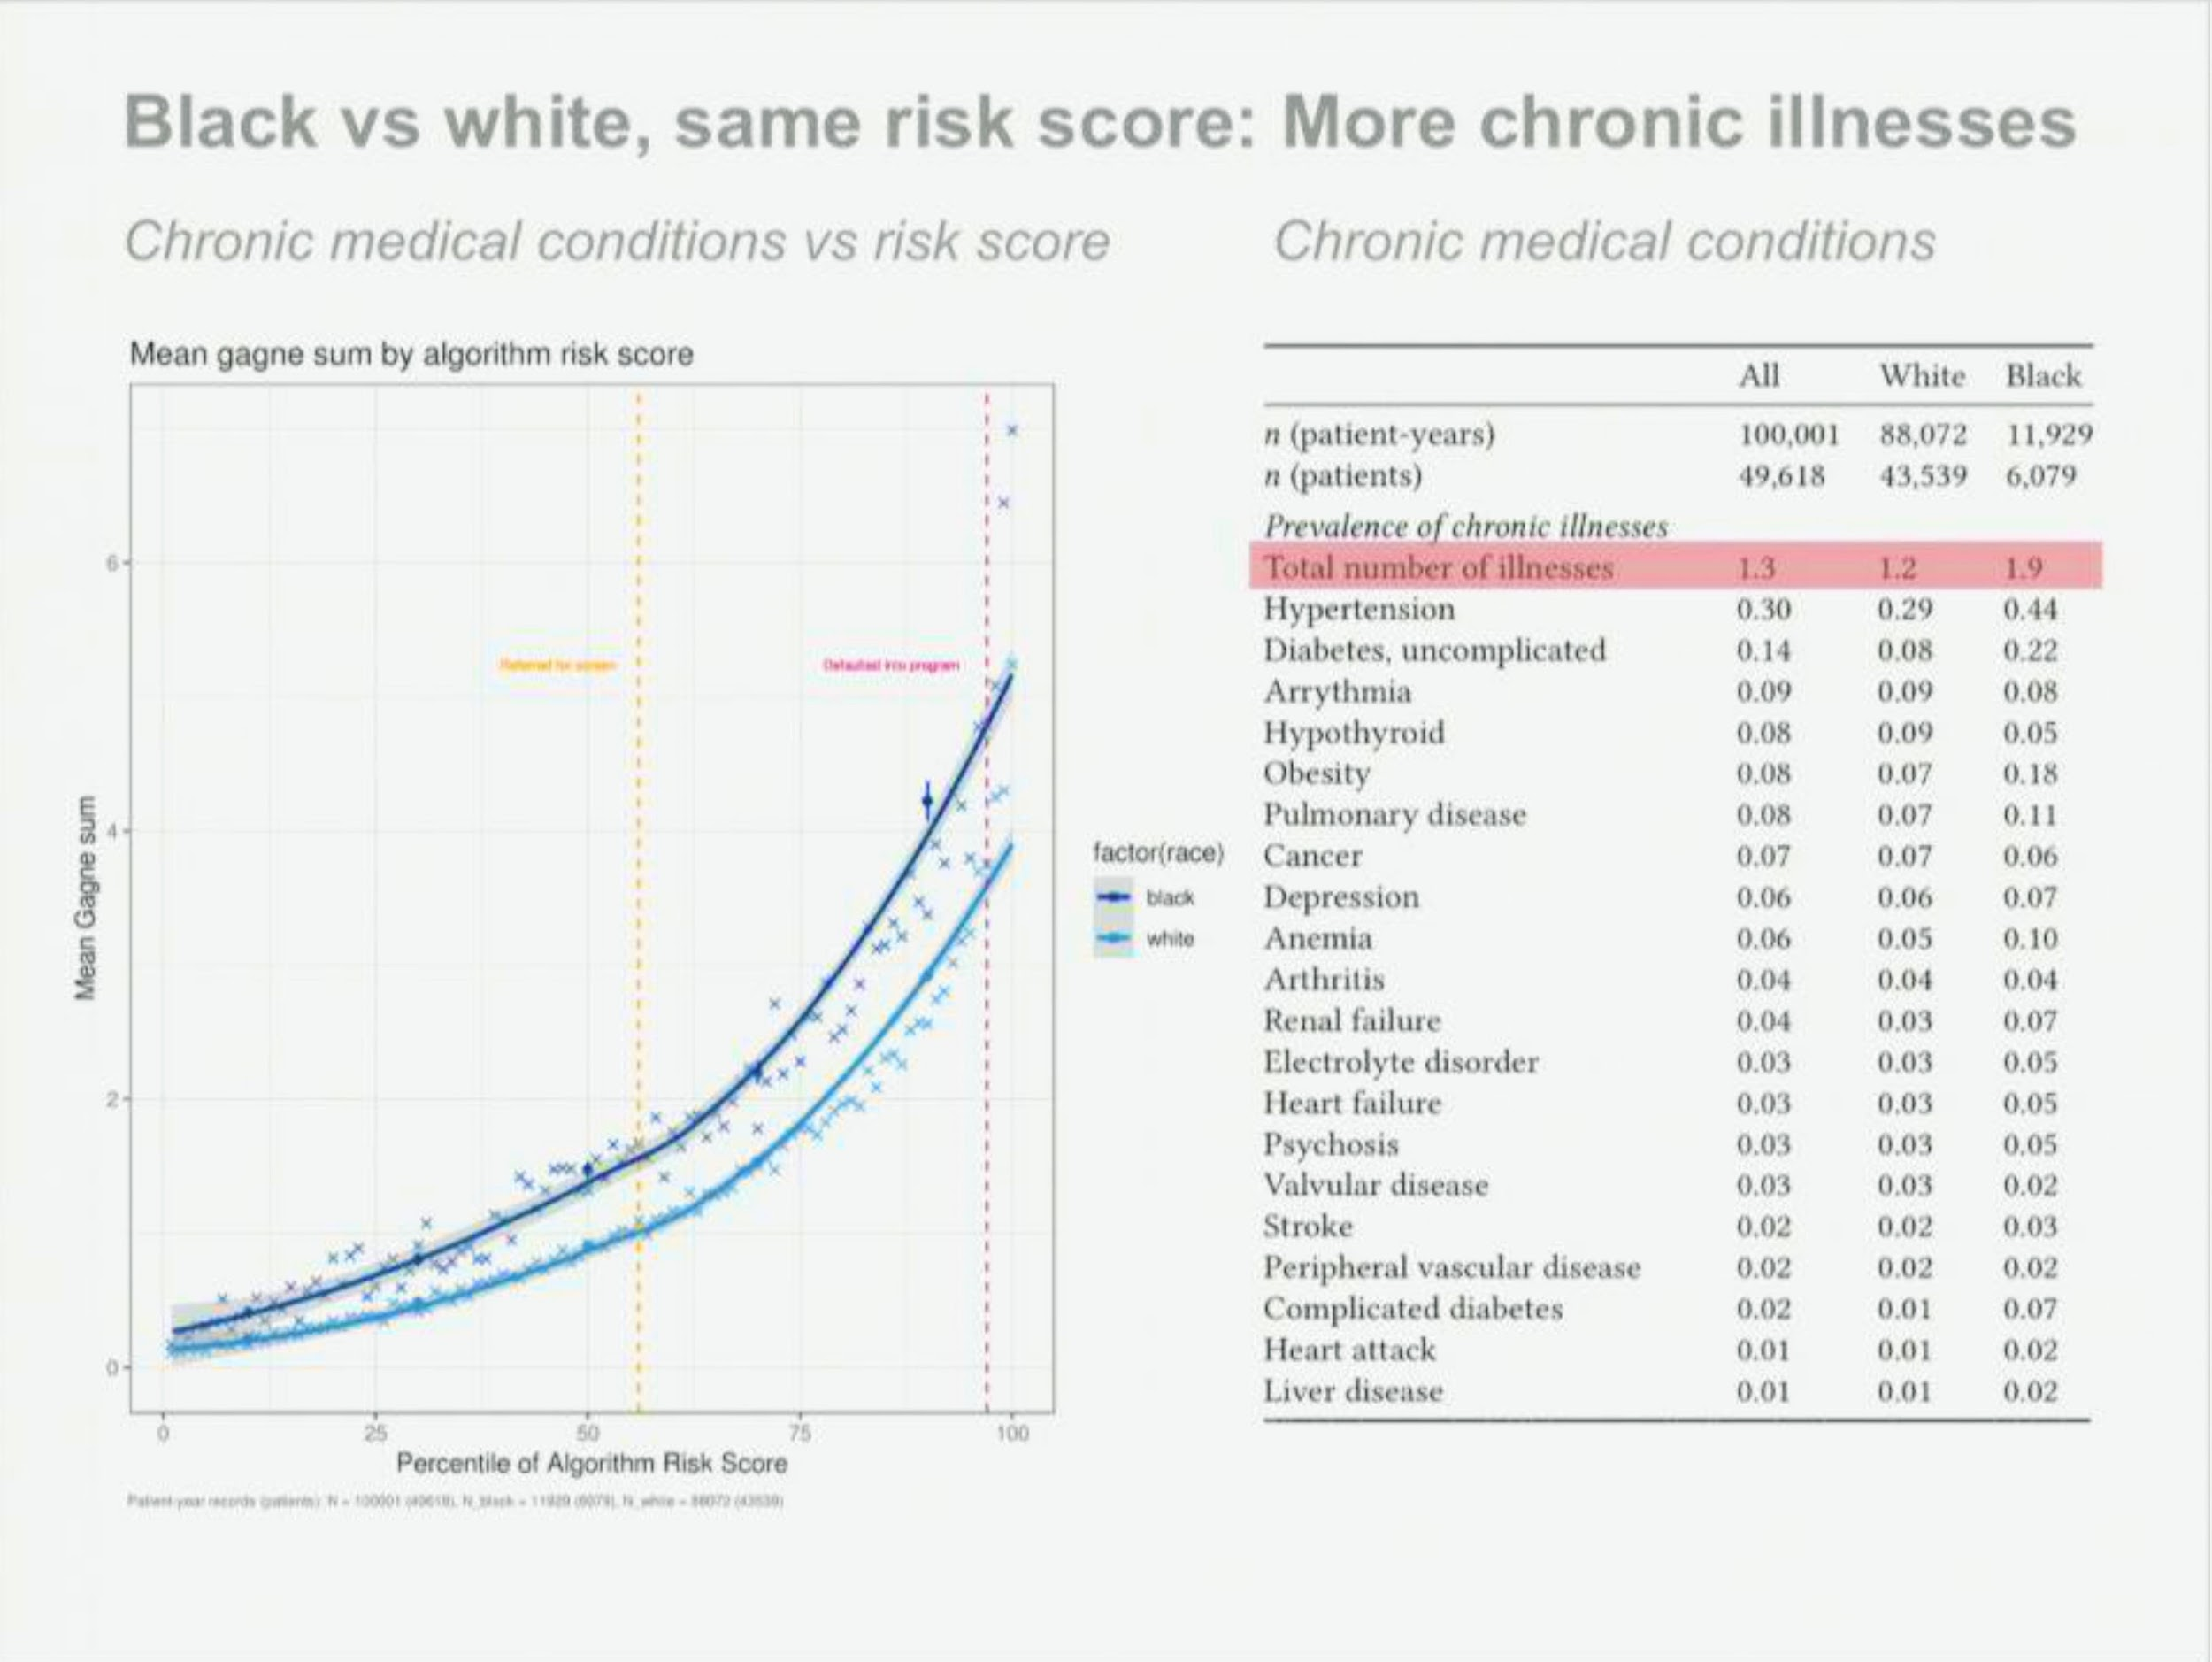
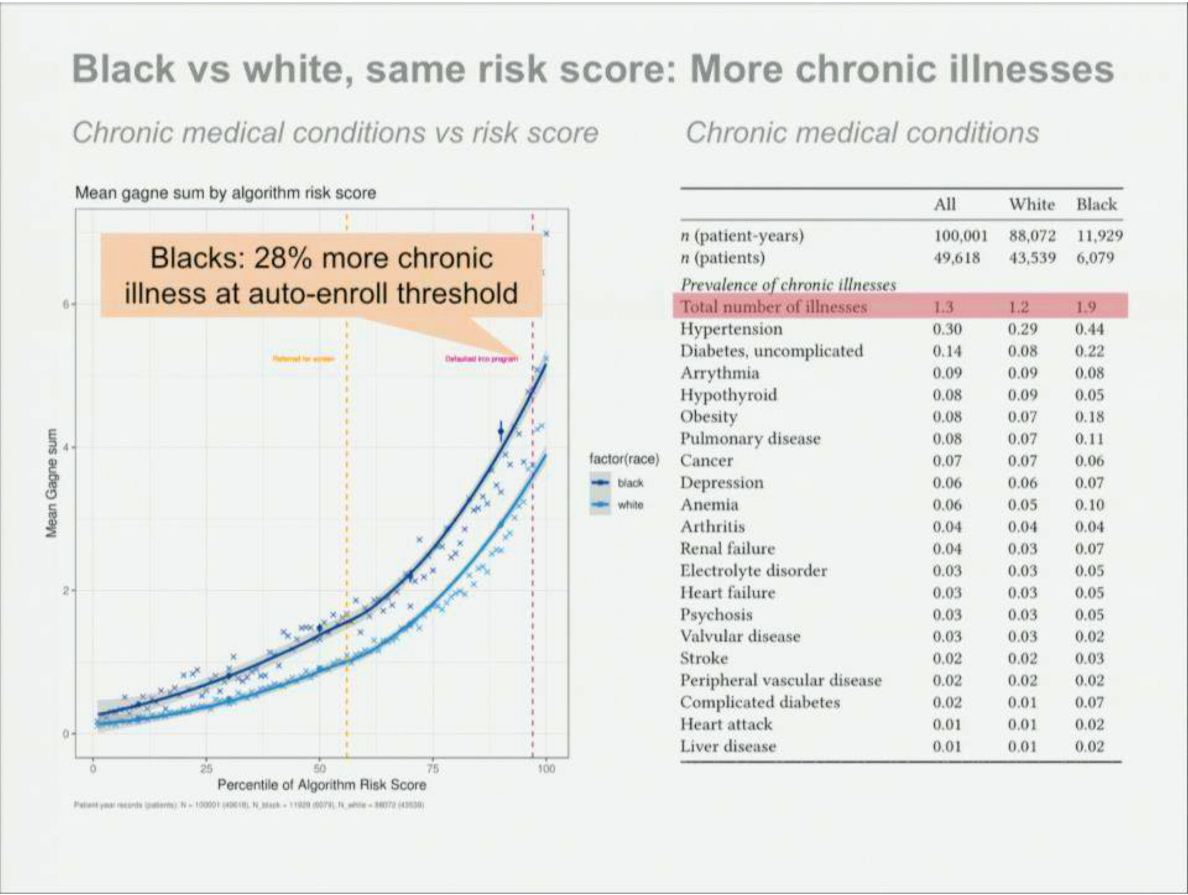
Black vs White Percentile Risk score

Slide 47
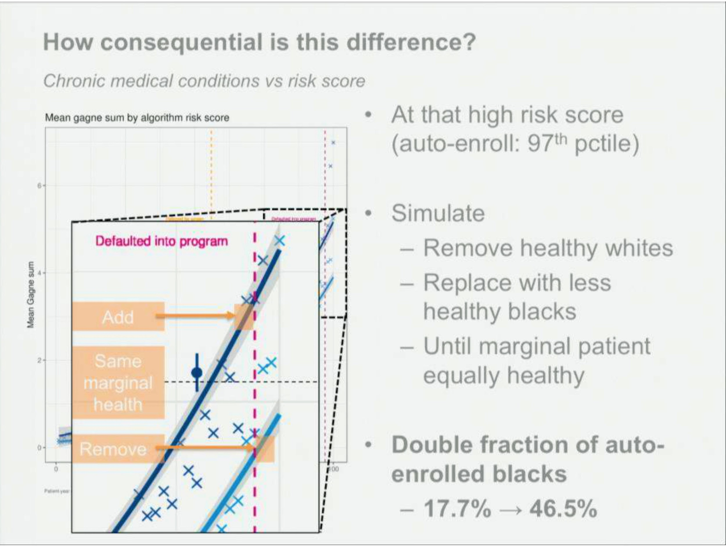
Consequential Difference

Slide 48
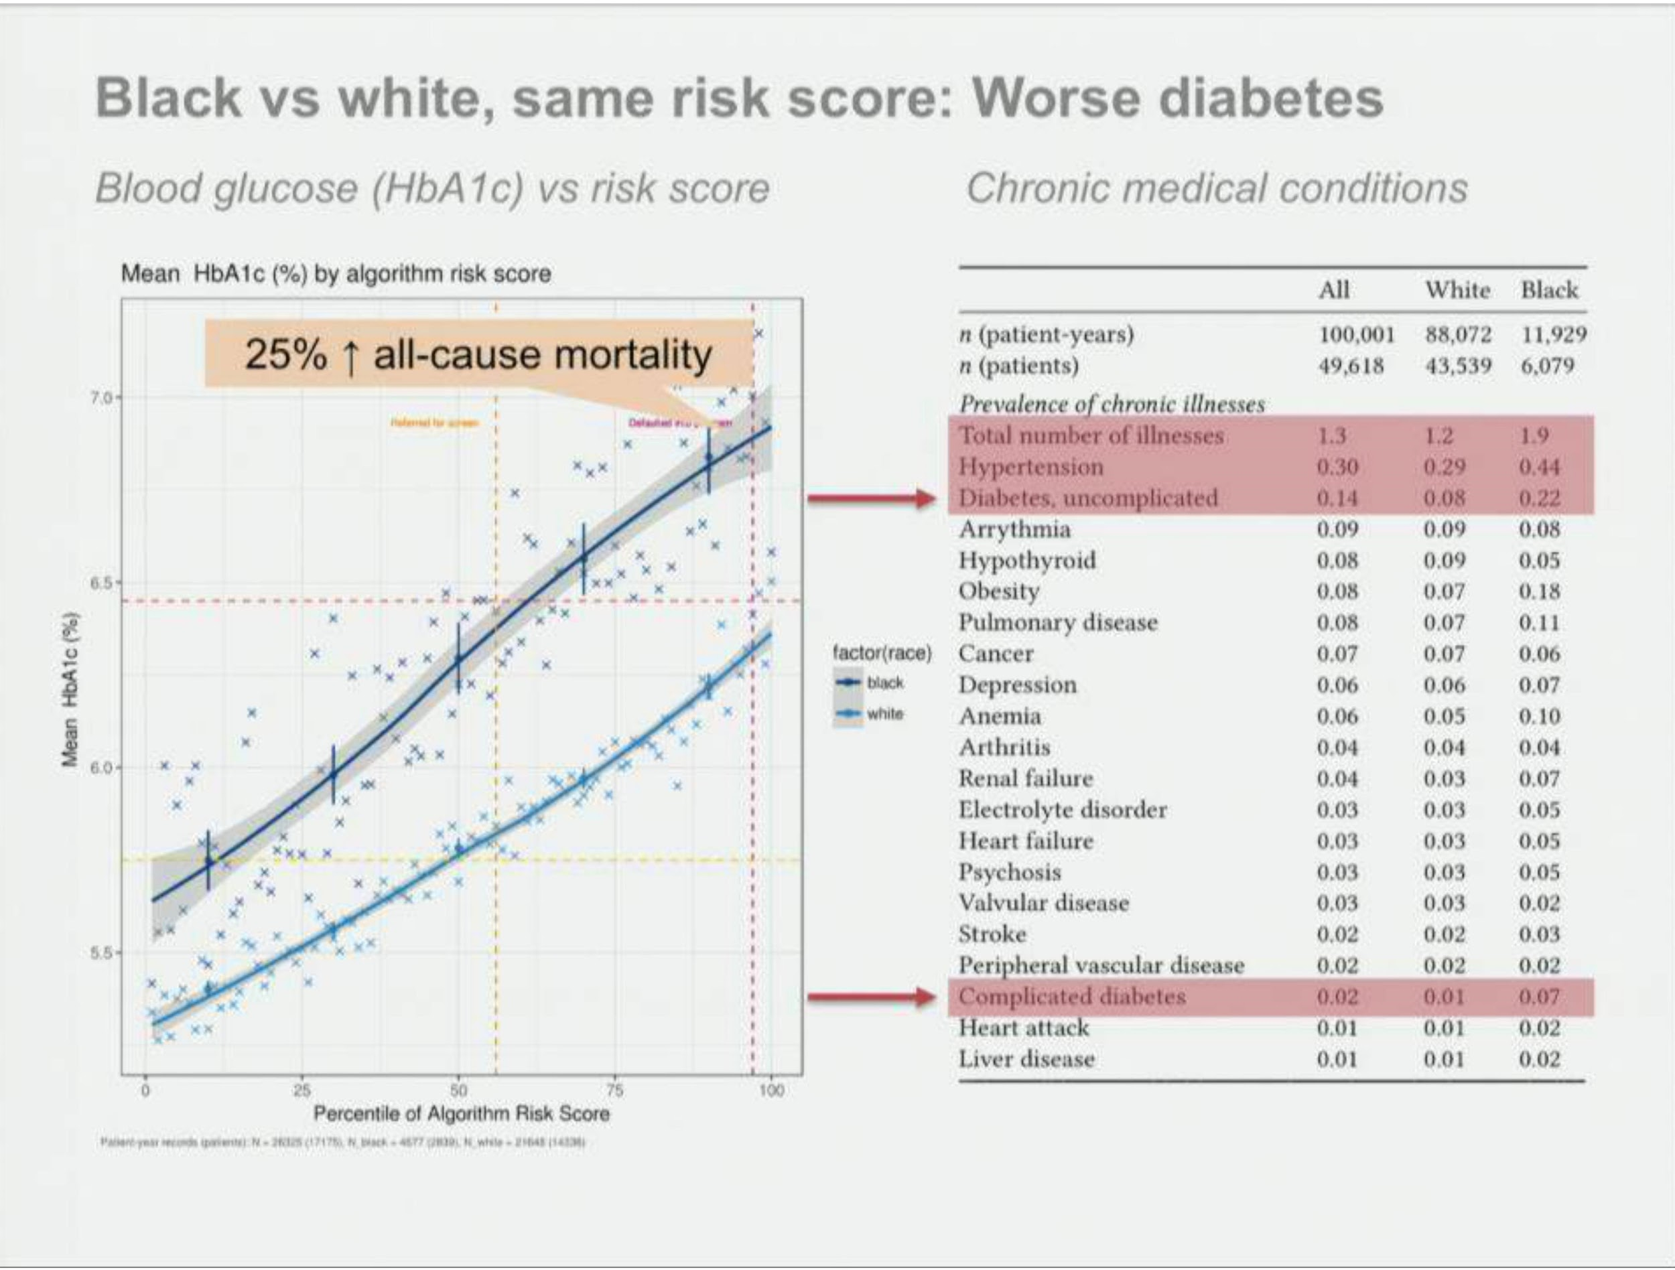

Slide 49
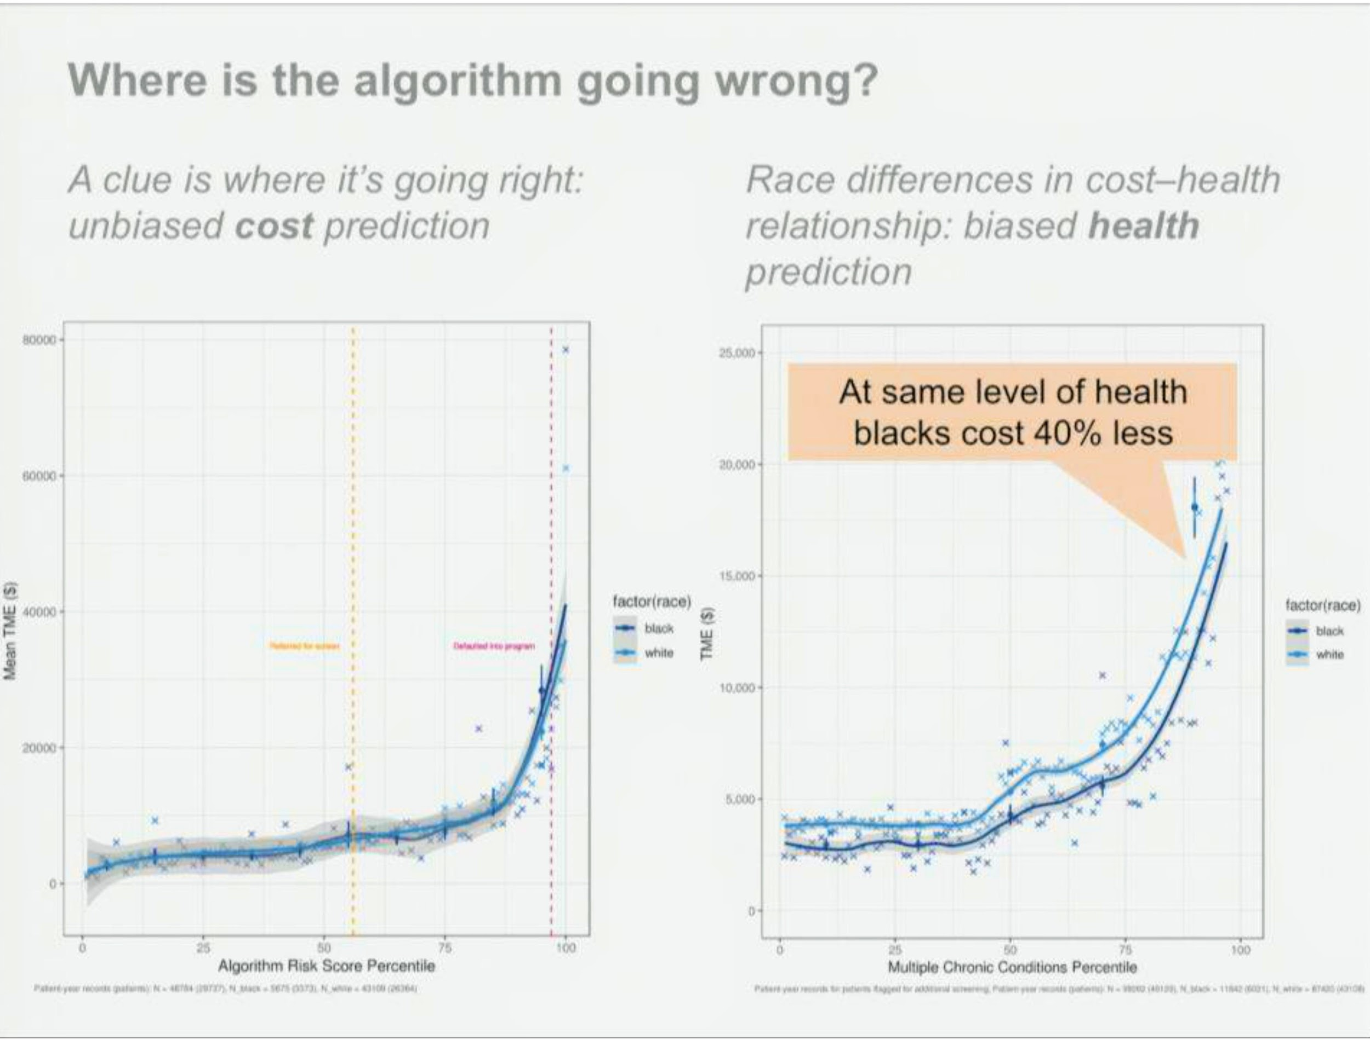
Algorithm gone wrong

Slide 50
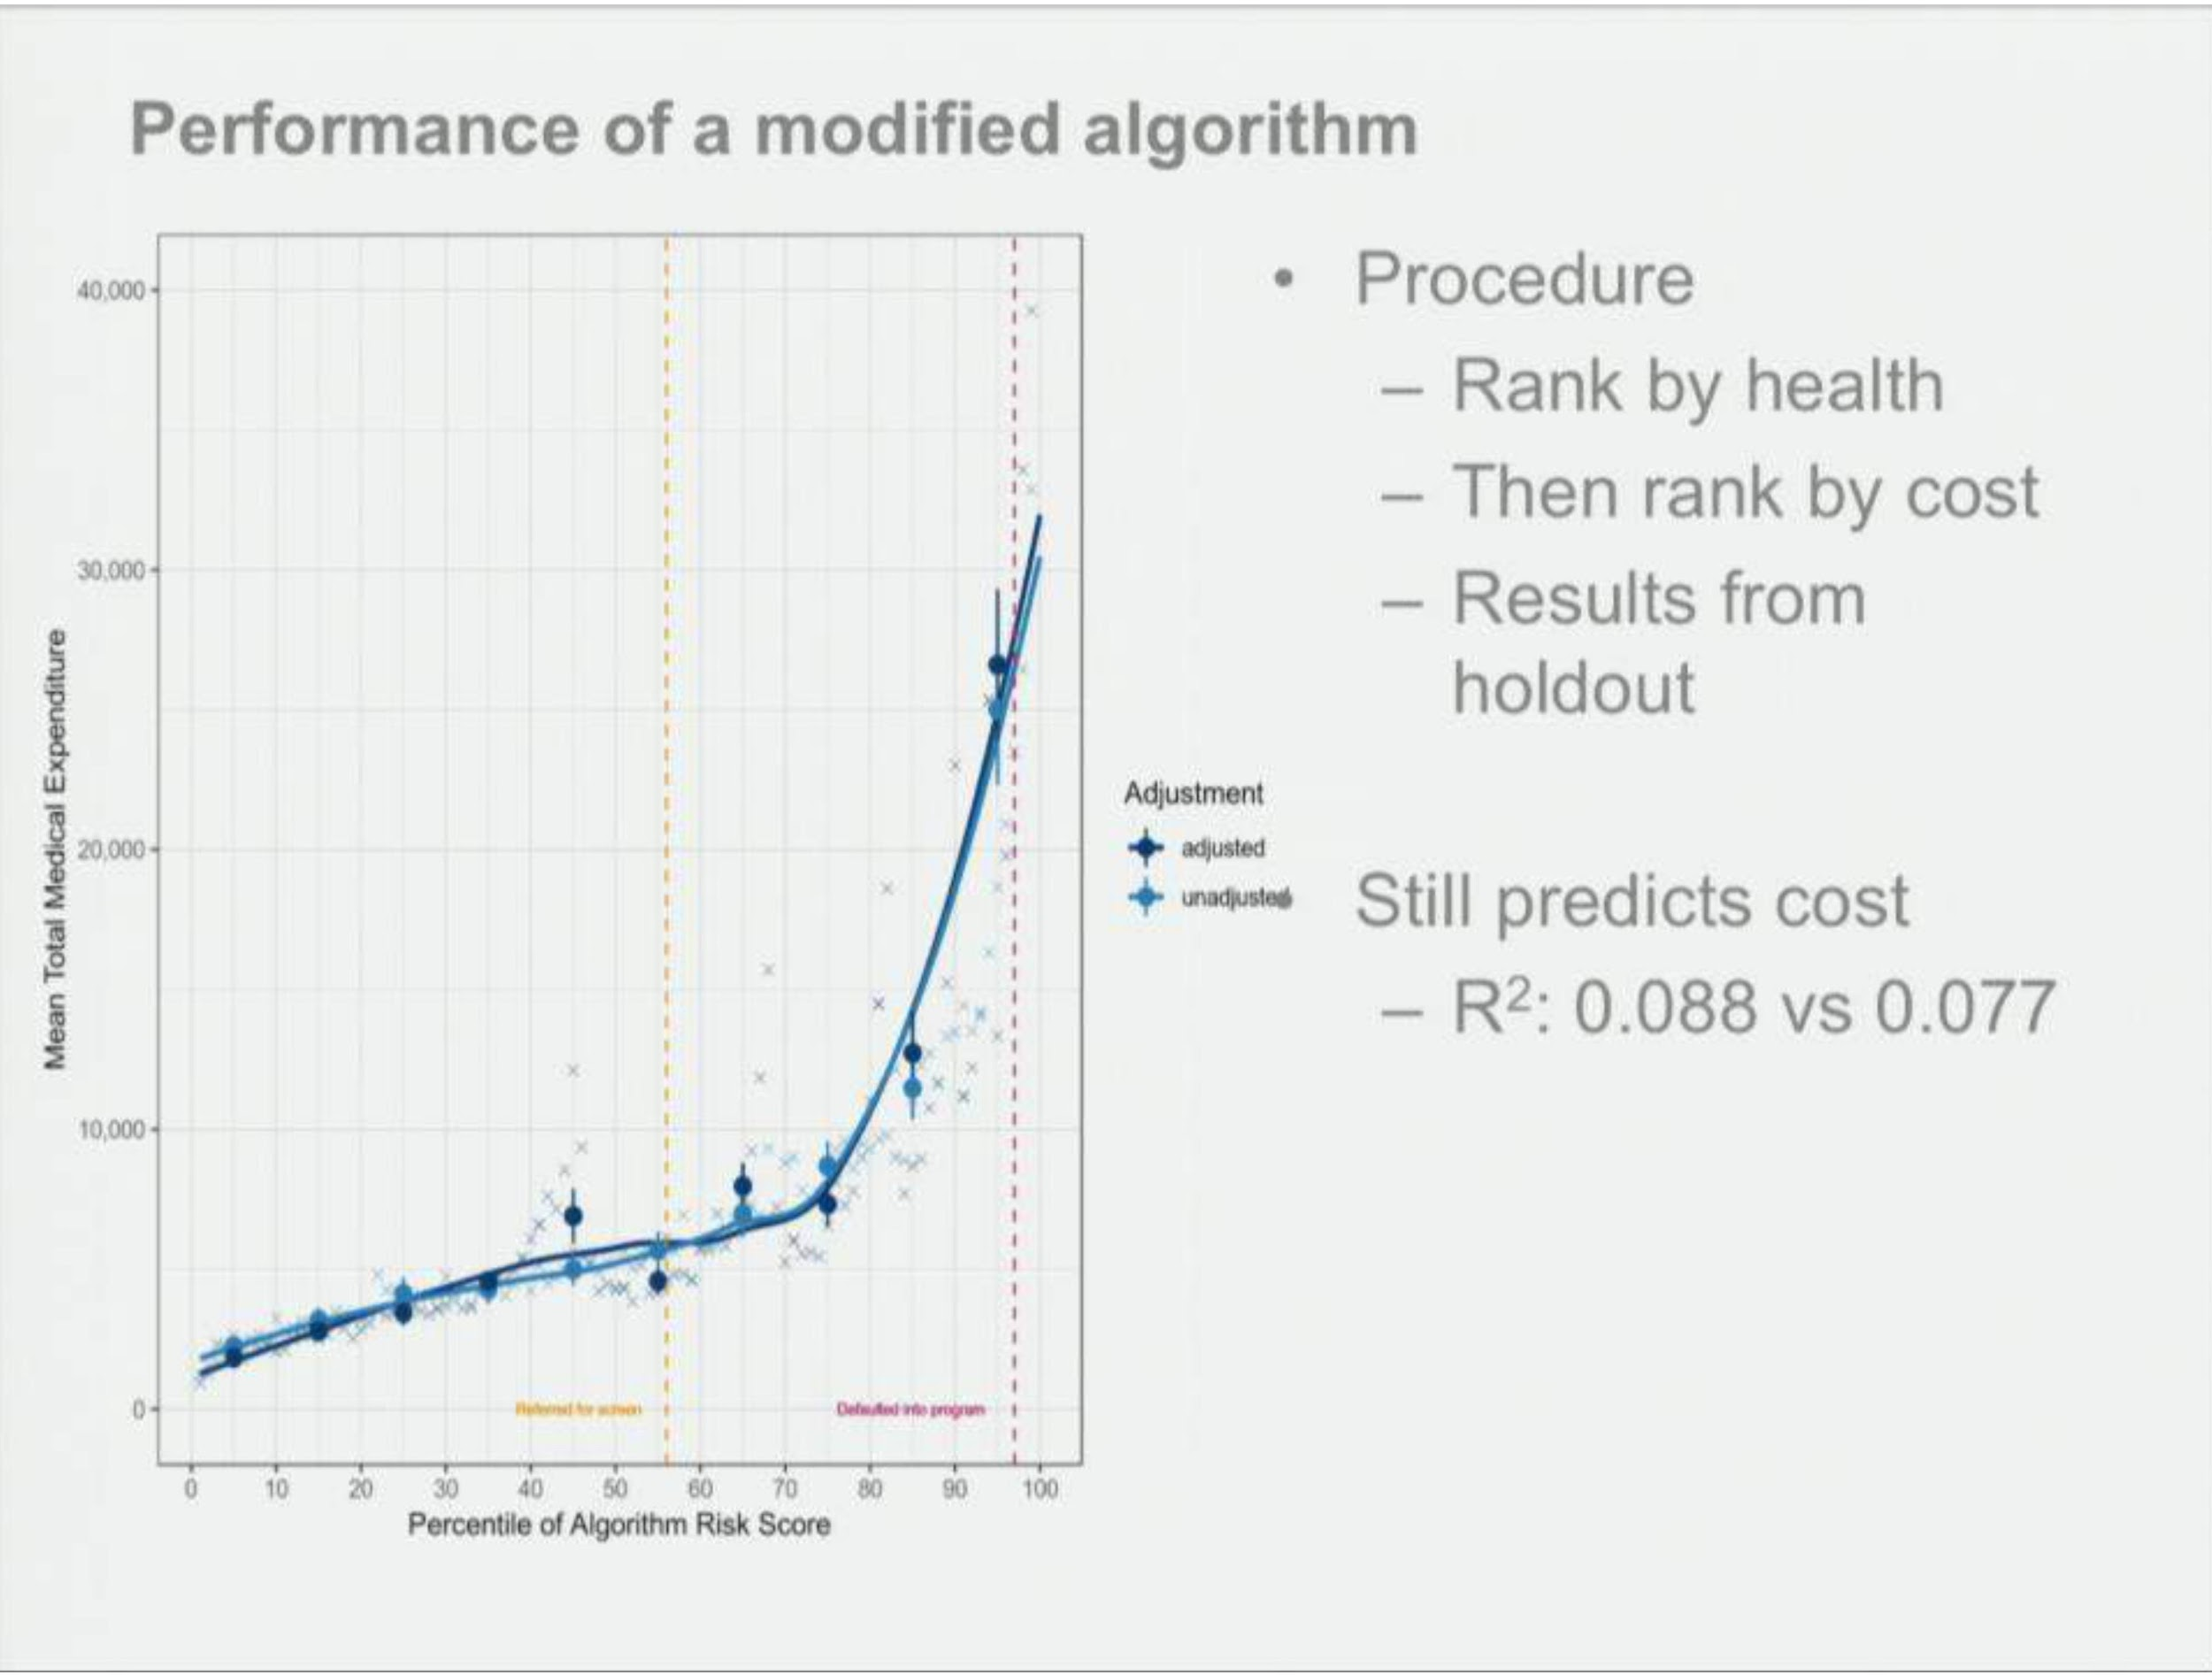
PROPOSED MODIFIED SOLUTION

Slide 51
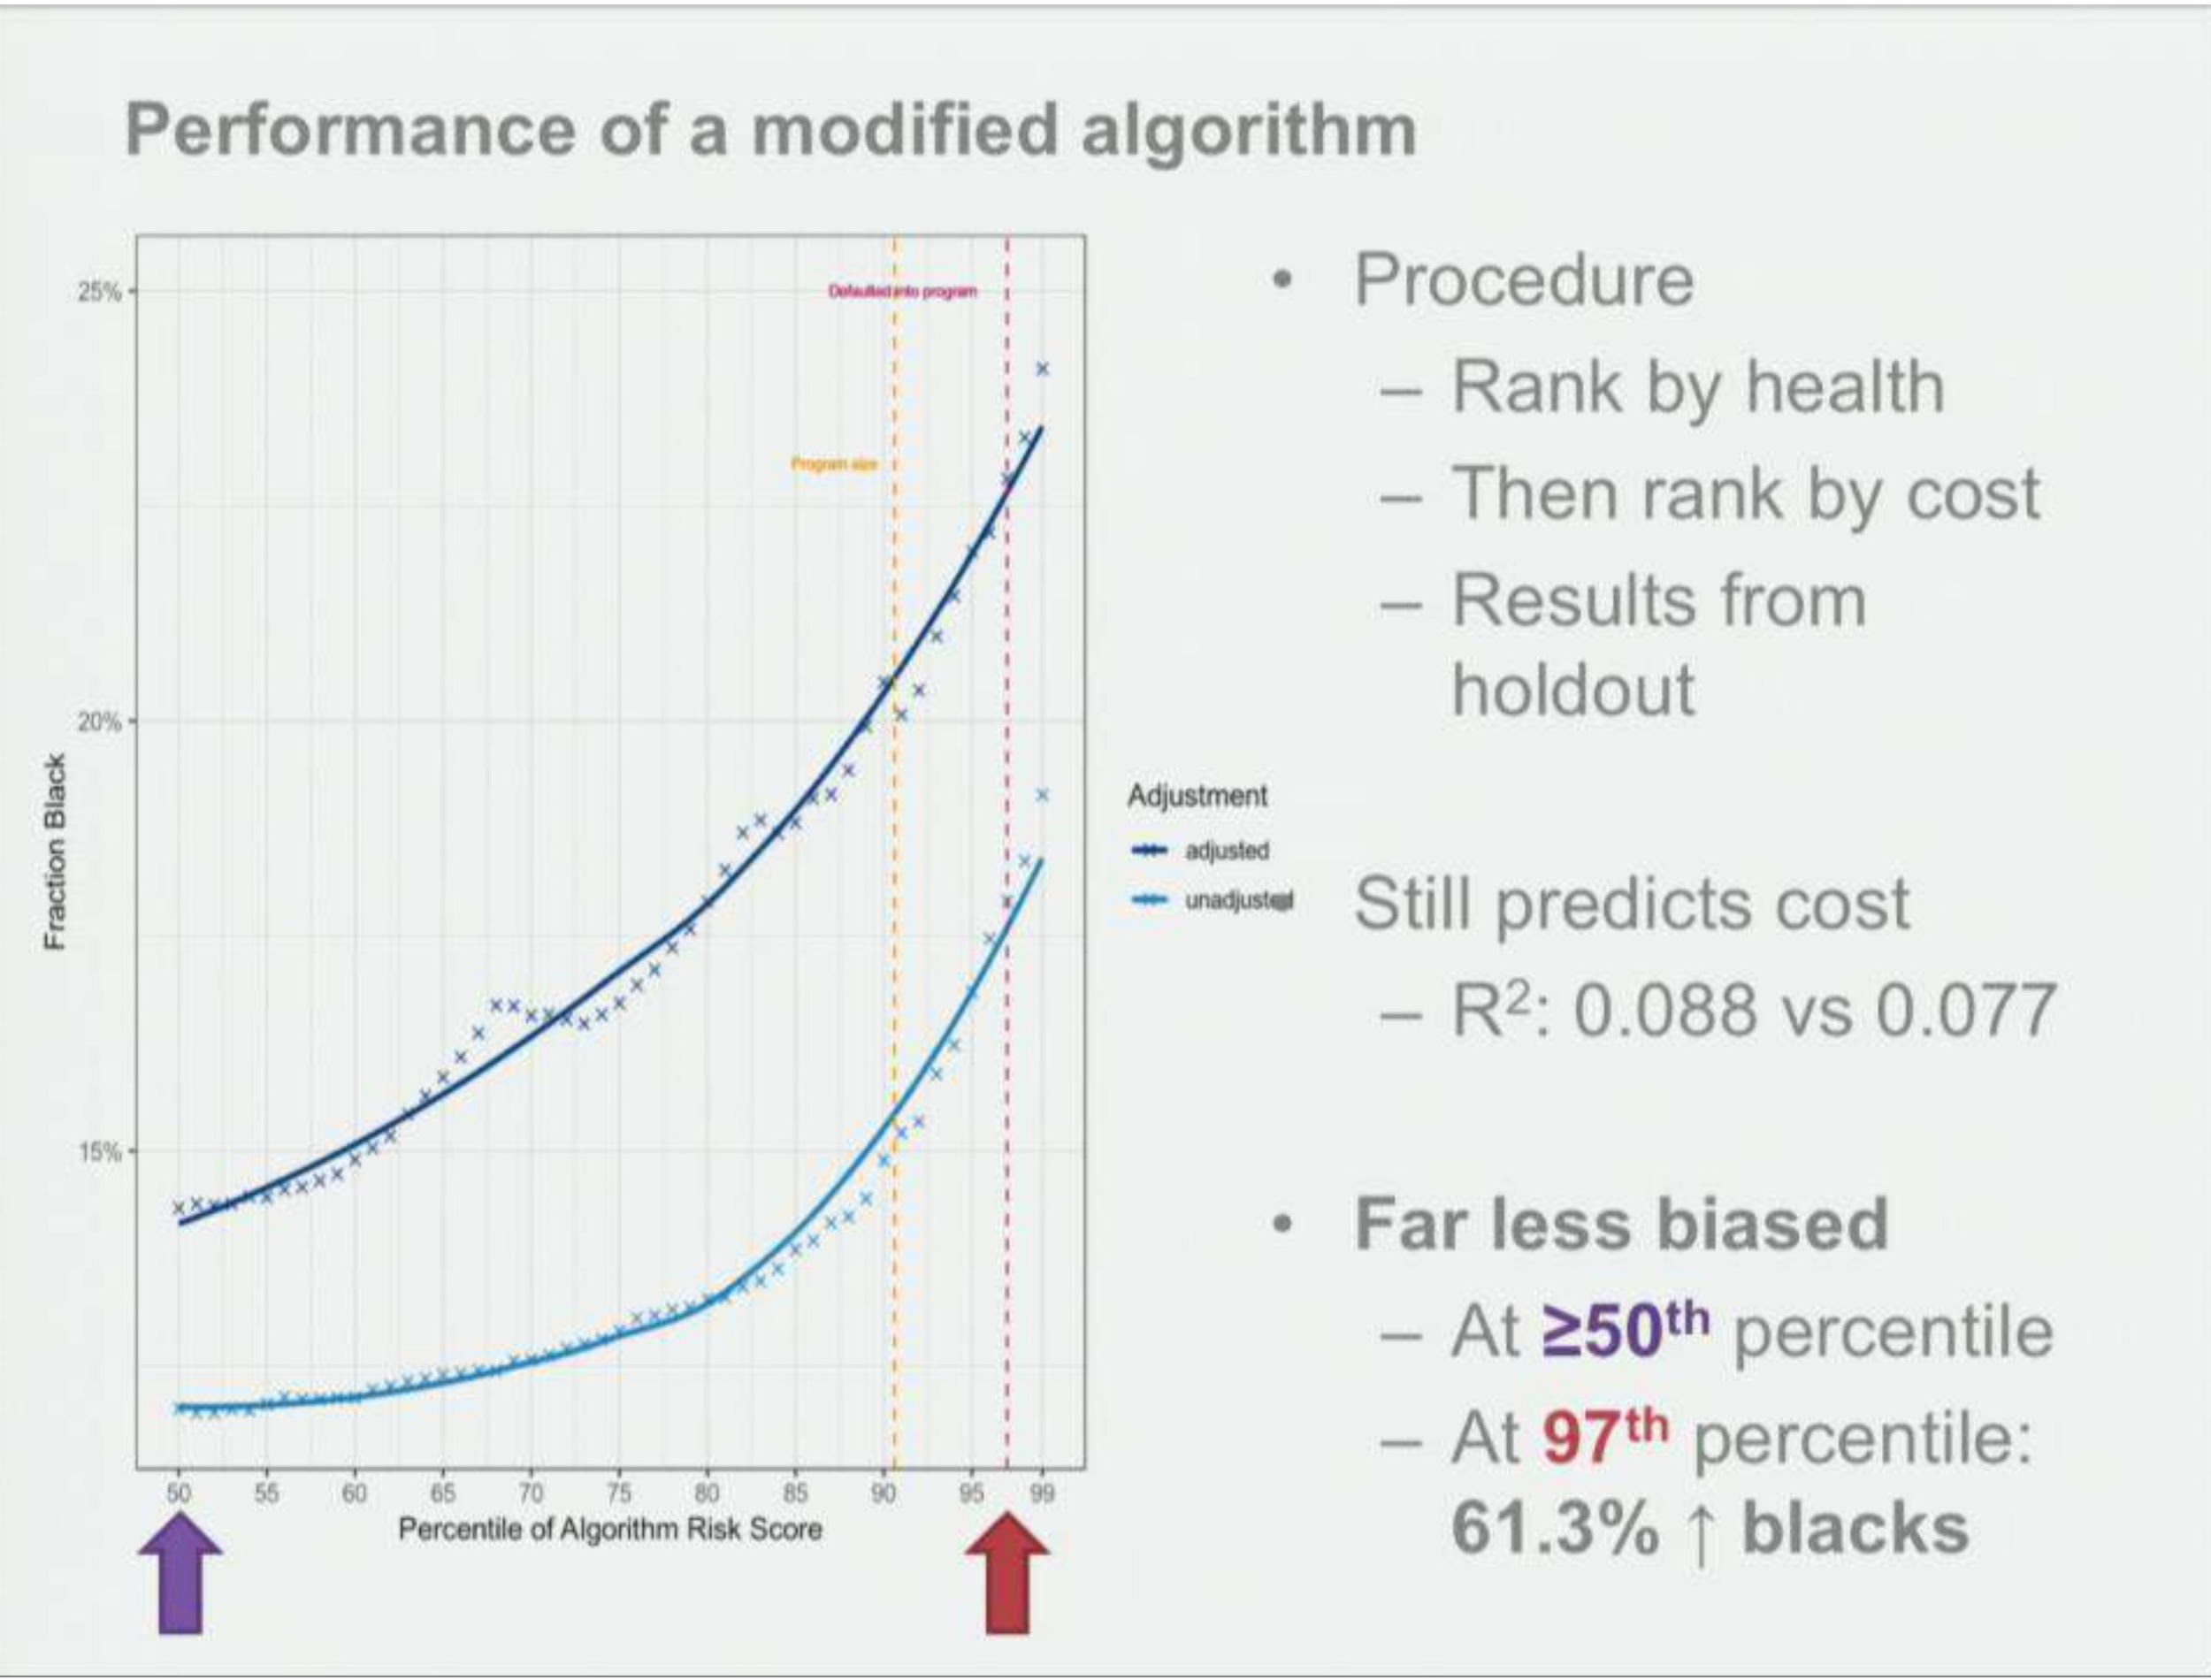

Slide 52
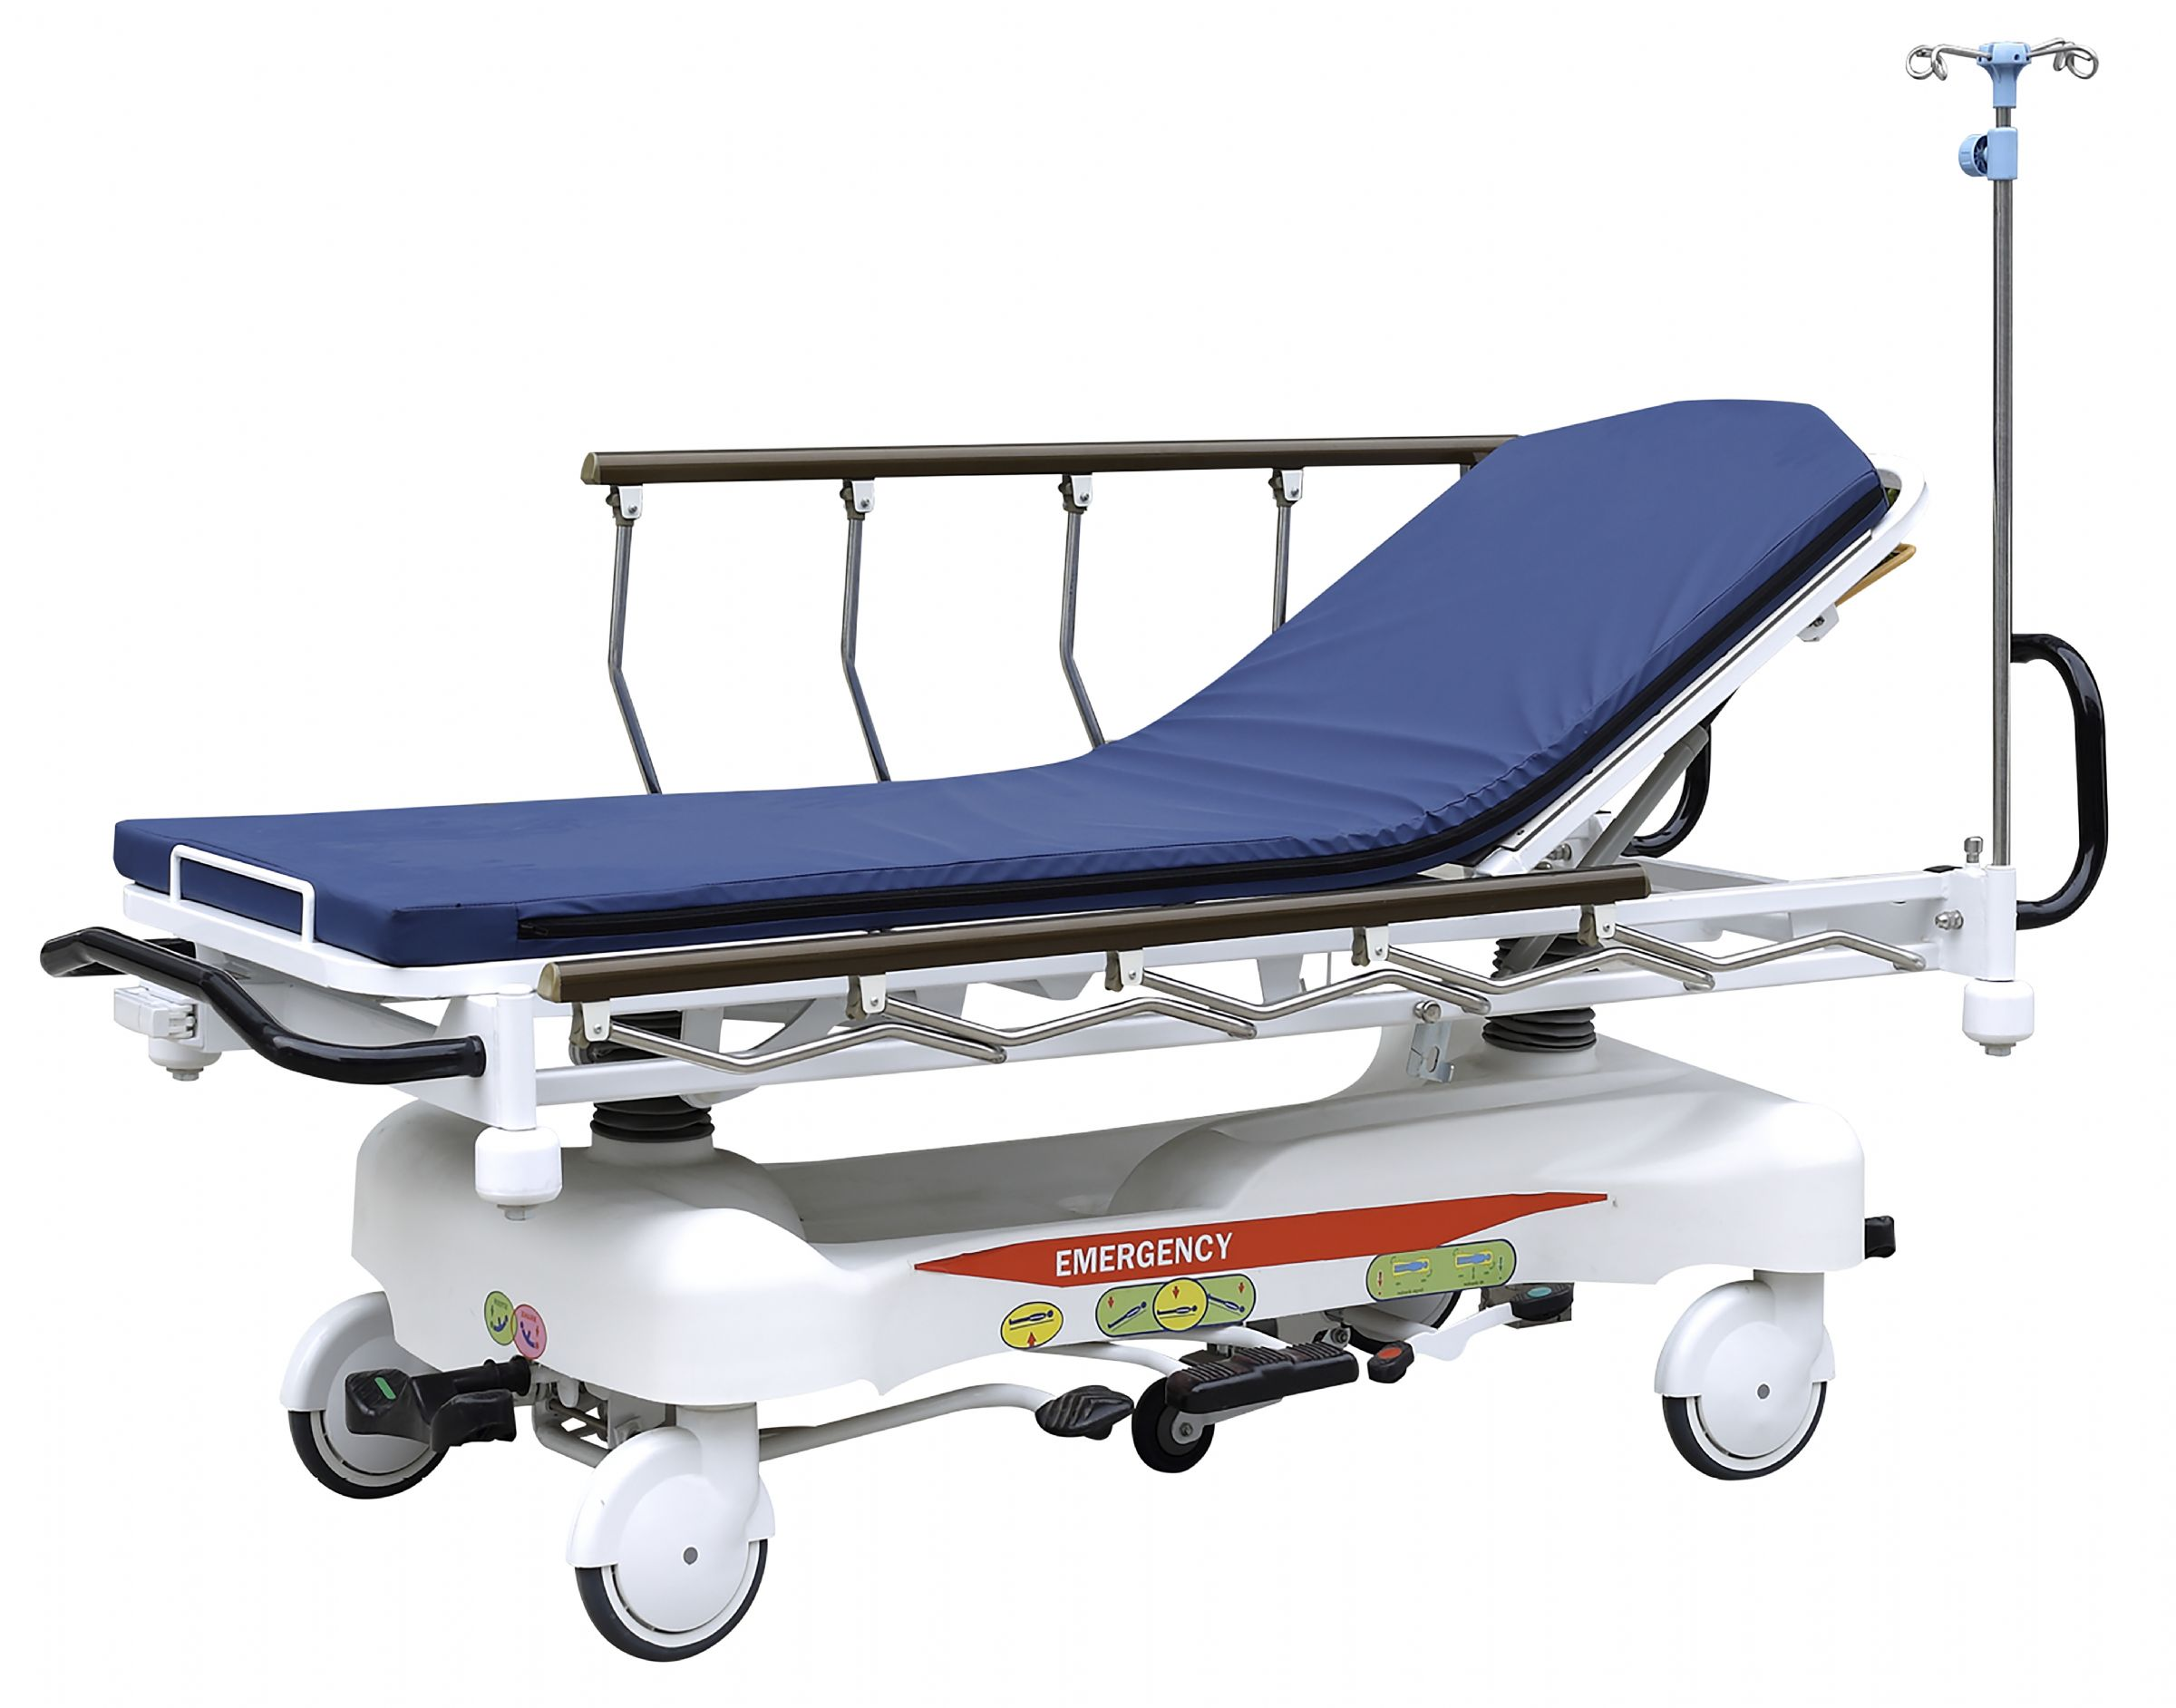
Inequality in Healthcare
Data : Electronic Medical Record Data
Project : Decrease the length of stay of patients in the hospital. Assign case manager to the patients
Bias: Wealthier / poverty population
Bias Variable : Adding zipcode of the patients increased the accuracy model
Mitigate Bias : Check Data, the formulas themselves and how the formulas are used.

Slide 53
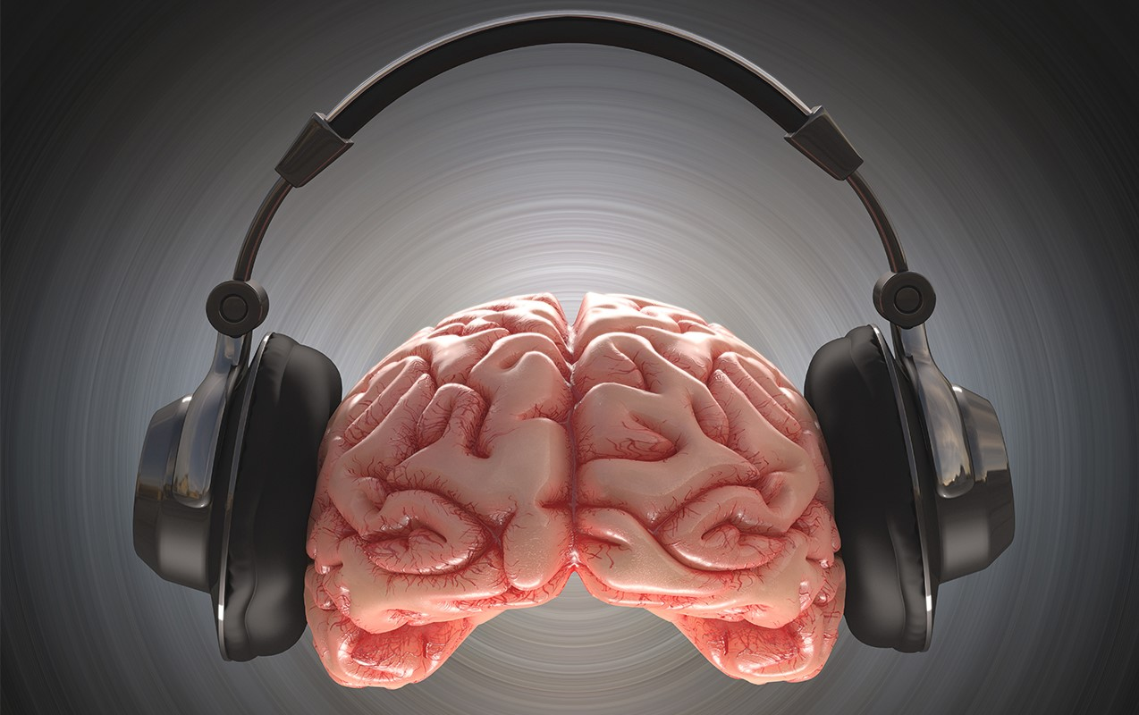
Data Selection Bias
Data : Native English Speakers
Project : Building Auditory device for neurological diseases
Bias : Native / Non-native population
Bias variable : Data itself
Mitigate bias : Unbiased medical datasets.

Slide 54
Discussion Questions

Slide 55
Resources

Slide 56
Debiasing Word Embeddings:
Tolga Bolukbasi, Kai-Wei Chang, James Zue, et al. 2016. Man is to computer as woman is to homemaker? Debiasing word embeddings. arXiv:1607.06520. Retrieved from https://arxiv.org/pdf/1607.06520.pdf

Slide 57
Automatic Gender Recognition:
FRS in government regulation:
https://www.flawedfacedata.com/
https://www.nytimes.com/2019/04/14/technology/china-surveillance-artificial-intelligence-racial-profiling.html
https://www.cbp.gov/travel/biometrics
Rekognition's customers:
https://aws.amazon.com/rekognition/customers/?linkCode=w61&imprToken=sUDpp5QFyOHJZXsWbnae6A&slotNum=4&ascsubtag=046e23a86449978ffb4cdd5bc2b5519b36e3015c&tag=jezebelamzn-20
Microsoft turned down FRS sales due to human rights concerns:
https://www.reuters.com/article/us-microsoft-ai/microsoft-turned-down-facial-recognition-sales-on-human-rights-concerns-idUSKCN1RS2FV
Rekognition's failure to identify women of color:
https://www.utoronto.ca/news/study-u-t-engineering-student-mit-takes-aim-biased-ai-facial-recognition-technology
https://www.aclunc.org/blog/amazon-teams-law-enforcement-deploy-dangerous-new-face-recognition-technology
LGBT stock photos:
https://broadlygenderphotos.vice.com/ Rekognition's gender assignment software:
https://docs.aws.amazon.com/rekognition/latest/dg/API_Gender.html?linkCode=w61&imprToken=sUDpp5QFyOHJZXsWbnae6A&slotNum=6 AGI effects on the LGBTQ+ population:
http://newsroom.ucla.edu/stories/male-or-female
https://jezebel.com/amazons-facial-analysis-program-is-building-a-dystopic-1835075450
https://ironholds.org/resources/papers/agr_paper.pdf
https://reallifemag.com/counting-the-countless/
https://www.theverge.com/2017/8/22/16180080/transgender-youtubers-ai-facial-recognition-dataset

Slide 58
Racial Bias in Criminal Justice:
Everything Cathy O'Neil
https://weaponsofmathdestructionbook.com/
https://blogs.scientificamerican.com/roots-of-unity/review-weapons-of-math-destruction/
https://en.wikipedia.org/wiki/Weapons_of_Math_Destruction
https://www.youtube.com/watch?v=_2u_eHHzRto
https://www.youtube.com/watch?v=TQHs8SA1qpk
Facial Recognition Issues
https://www.aclu.org/blog/privacy-technology/surveillance-technologies/amazons-face-recognition-falsely-matched-28
https://slate.com/technology/2019/03/facial-recognition-nist-verification-testing-data-sets-children-immigrants-consent.html
https://jezebel.com/amazons-facial-analysis-program-is-building-a-dystopic-1835075450
https://www.washingtonpost.com/technology/2019/04/30/amazons-facial-recognition-technology-is-supercharging-local-police/?noredirect=on&utm_term=.5822334cf717
Algorithms in Sentencing Guidelines
https://points.datasociety.net/systemic-algorithmic-harms-e00f99e72c42
https://www.propublica.org/article/machine-bias-risk-assessments-in-criminal-sentencing
https://www.nytimes.com/2017/10/26/opinion/algorithm-compas-sentencing-bias.html
https://www.nytimes.com/2017/12/20/upshot/algorithms-bail-criminal-justice-system.html
https://muse.jhu.edu/article/645268/pdf
Making The Algorithms Better https://arxiv.org/pdf/1712.00193.pdf
Fairness, Accountability, and Transparency in Machine Learning https://www.fatml.org/

